Slide 1

Parallel SOSP & MOSP
Efficient parallel algorithms for updating single and multi-objective shortest paths in dynamic networks with edge changes

Slide 2
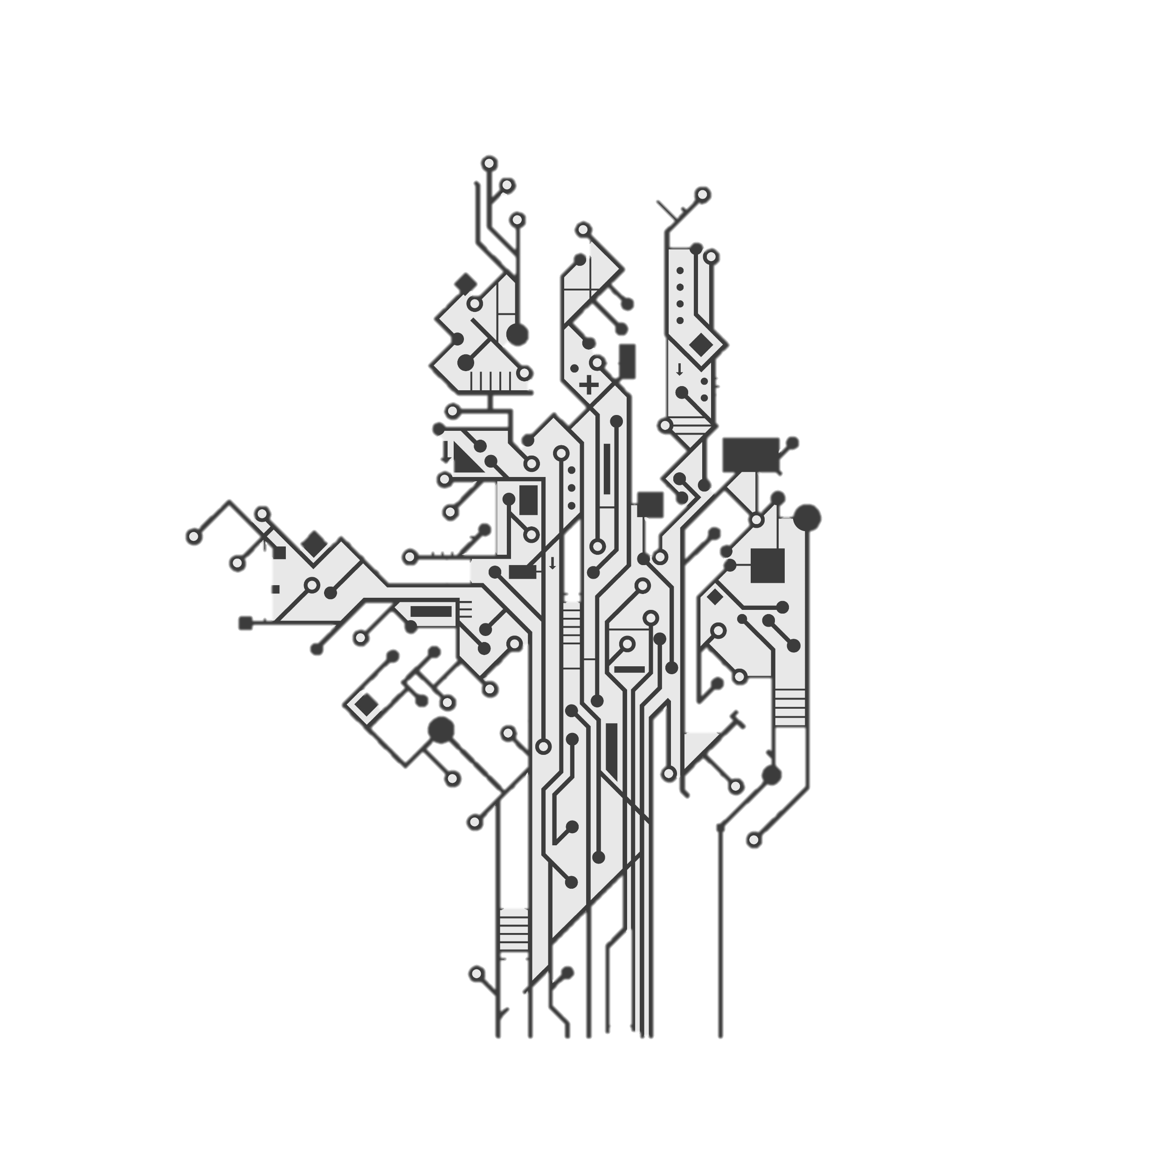
Problem Addressed
Dynamic Networks:
Networks with frequent topology changes (e.g., edge additions).
Applications: Road, social, communication, and drone networks.
Shortest Path Challenges:
SOSP: Finds minimal-weight path for one objective.
MOSP: Balances multiple conflicting objectives.
Recomputing paths after changes is costly; MOSP is complex.
Objective:
Develop parallel algorithms to update SOSP efficiently.
Create heuristic for single MOSP update in large graphs
Ensure scalability and practicality via shared-memory parallelism

Slide 3

Theoretical Key Concepts
Graph Representation:
Directed graph with vertices and edges.
SOSP: Edges have a single weight (e.g., distance).
MOSP: Edges have multiple weights (e.g., time, fuel).
Single-objective Shortest Path (SOSP):
Finds shortest paths from a source for one objective.
Produces a tree of shortest paths.
Updates paths incrementally in dynamic networks.
Multi-objective Shortest Path (MOSP):
Optimizes multiple objectives, producing paths where no objective can improve without worsening another.
Labels vertices with sets of optimal paths from different parents.
Filters out suboptimal paths dominated by others.
Combines single-objective paths into a unified graph for balanced optimization.
Dynamic Networks:
Networks with changing topology, focusing on edge additions.
Aim: Update shortest paths efficiently without recomputation

Slide 4
Update Algorithms
SOSP Update (Algorithm 1):
Purpose: Efficiently updates the single-objective shortest path tree in dynamic networks with edge insertions.
Features: Eliminates race conditions via grouping, enhances scalability with parallel processing, reduces iteration compared to prior methods.
MOSP Update (Algorithm 2):
Purpose: Heuristically updates a single multi-objective shortest path, balancing multiple objectives..
Features: Converts NP-hard MOSP problem to a tractable SOSP problem, customizable for objective priorities.
Theoretical Foundations:
Theorem 1: Combined graph approach ensures Pareto-optimal MOSP under unique SOSP trees.
Lemma 2: Paths in SOSP trees are subpaths of Pareto-optimal MOSPs.
Theorem 3: Guarantees a Pareto-optimal MOSP in updated dynamic graphs with unique SOSP trees.

Slide 5
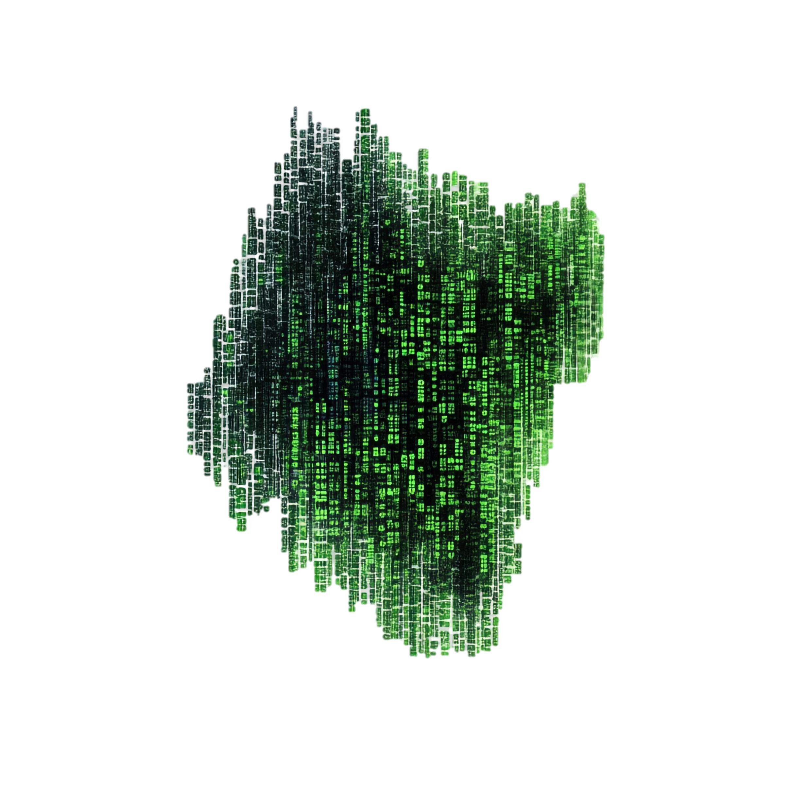
Implementation Overview
Environment:
C++ with OpenMP for shared-memory parallelism.
Dual 32-core CPUs, 64 GB RAM.
Data Structures:
Graph stored as adjacency list.
Changed edges track endpoints and status.
SOSP tree holds parent-child links and distances.
Affected vertices flagged during updates.
Parallelization:
SOSP: Parallel edge groups and neighbor updates, dynamic thread scheduling.
MOSP: Sequential SOSP tree updates, parallel combined graph creation, and shortest path computation.
Optimizations:
Edge grouping minimizes iterations.
Efficient edge collection using tree relationships.

Slide 6

Performance Evaluation Overview
Experimental Setup:
Datasets: Large road networks and random geometric graphs.
Dynamic Changes: Batches of edge insertions.
Metrics: Focus on execution time and scalability.
Scalability Analysis:
Increasing parallel threads reduces execution time.
Sparse, large graphs scale better due to lower contention.
Smaller graphs with many edge changes face scalability limits.
Time Breakdown:
SOSP updates consume most execution time.
Combined graph creation is fast.
Shortest path computation in combined graph takes minimal time.
Observations:
No prior parallel MOSP update algorithms for dynamic networks.
Sparse graphs outperform denser ones.
Optimizing SOSP updates is key to MOSP performance.

Slide 7
Related Work Overview
Multi-objective Shortest Path:
Early bi-objective methods evolved to include Pareto optimality.
Label-setting and heuristic-based algorithms explored, but computationally heavy.
Parallel SOSP:
Parallelized classic algorithms and GPU-based solutions exist.
Dynamic updates focus on single objectives, not multi-objective.
MOSP in Dynamic Networks:
Adapted traditional algorithms for dynamic changes.
Addressed transportation and non-standard weights, but not parallelized.
Parallel MOSP:
Limited to bi-objective shared-memory solutions.
No prior work on parallel MOSP in large dynamic graphs, highlighting this paper’s novelty.

Slide 8
Key Contributions
Parallel SOSP Update Algorithm:
Efficiently updates SOSP trees using grouping to avoid race conditions and reduce iterations.
Scalable for large incremental networks.
Heuristic MOSP Update Algorithm:
Novel approach to find a single Pareto-optimal MOSP by leveraging SOSP updates.
Reduces NP-hard MOSP complexity to SOSP, improving execution time.
Customizable weight assignments for objective balancing or prioritization.
Shared-Memory Implementation:
C++ and OpenMP implementation validated on real and synthetic networks.
Achieves significant speedup (up to 15x) and scalability.
Theoretical Guarantees:
Proves Pareto optimality of the MOSP under unique SOSP tree conditions.
Practical Applicability:
Addresses real-world scenarios like drone delivery, where time and energy

Slide 9
Limitations and Future Work
Limitations
Future Work:
Extend to edge deletions.
Implement hybrid parallelism to update SOSP trees concurrently.
Develop distributed-memory implementations for massive graphs.
Explore GPU-based implementations for dense computations.
Focuses on edge insertions; edge deletions require adaptation.
Sequential SOSP tree updates for multiple objectives limit parallelism.
Shared-memory implementation may not scale to distributed systems.

Slide 10

Conclusion
The paper presents a pioneering approach to updating SOSP and MOSP in large dynamic networks, addressing a critical gap in parallel algorithms for dynamic MOSP.
The proposed algorithms are efficient, scalable, and theoretically sound, with practical applications in transportation, communication, and delivery systems.
The shared-memory implementation demonstrates significant performance gains, and future extensions to distributed systems and edge deletions promise further advancements.

